Slide 1
Creating Custom Journeys with Journey Builder: Integrating Third Party Events
Customer Journey Integration with Salesforce Marketing Cloud
Eliot Harper
Chief Technology Officer, Digital Logic
eliotharper@icloud.com
@eliotharper

Slide 2




About Me
Chief Technology Officer, Digital Logic
3+ years experience in Marketing Cloud development
Active contributor to Salesforce Stack Exchange
Author of Journey Builder Developer’s Guide
Free ebook at http://connections.jbdevelopers.guide
@eliotharper
eliotharper
linkedin.com/in/eliot

Slide 3
Session Goals
1
2
3
What to integrate
Journey Builder 101
Integration Options
How to integrate
Events Method
Contact Events Method
Tips & Best Practices
Contact Model Optimization
Real World Example

Slide 4
What to Integrate
Integrating Third Party Events with Journey Builder

Slide 5
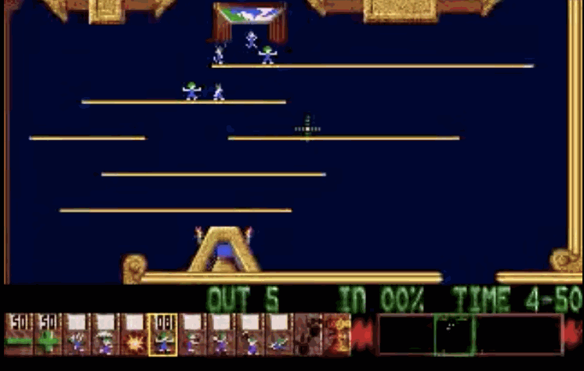

Journey Builder 101

Slide 6
Integration Options
What to Integrate with Journey Builder
Journey Builder has a highly extensible architecture
Interactions expressed as JSON, API enables Interaction editing and execution
Custom Activities and Events
Firing Event Options
Scheduled (via an Automation or within the Event): time-based frequency, batch process
API triggered: real-time, when the Event occurs

Slide 7
Journey Builder 101
What to Integrate with Journey Builder
Event Driven Interactions
adding items to a wish list on an e-commerce website
abandoning a cart on an e-commerce website
purchasing items on an e-commerce website or at a point-of-sale (POS) system
a mobile device coming into proximity with a Bluetooth beacon
completing an online registration form
IoT events

Slide 8
How to Integrate
Integrating Third Party Events with Journey Builder

Slide 9

Events Method
HOST: https://www.exacttargetapis.com POST /interaction/v1/events Content-Type: application/json Authorization: Bearer insertAccessToken
{ "contactKey":"M1234", "eventDefinitionKey":"CONTACT-EVENT-x…", "EstablishContactKey":true, "data":{ "memberId":"M1234", "firstName":"Frank", "lastName":"Smith”, "email":"frank@acme.com" } }
How to Integrate with Journey Builder
Used to serialize Contact data into the Event Source Data Extension
Optionally creates a Contact Record
Fires the Entry Event: Contacts enter the Interaction(s) related to the Event (if they meet the Event Contact Filter Criteria)

Slide 10
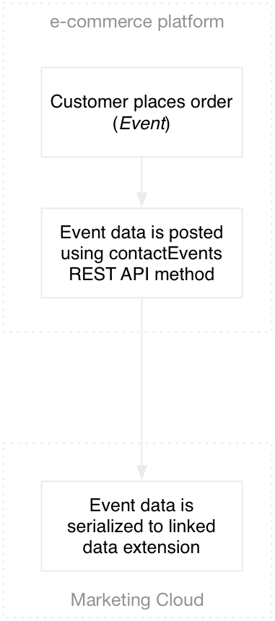
Contact Events Method
HOST: https://www.exacttargetapis.com POST contacts/v1/contactEvents Content-Type: application/json Authorization: Bearer insertAccessToken
{ "contactKey":"M1234", "eventDefinitionKey":"CONTACT-EVENT-x…", "data":[{ "id": "5CE001F0-6B8F-E311-08EF6GXX", "name": "Member Preferences", "items": [{ "values": [{ "name": "email opt-in", "value": true }, { "name": "mobile opt-in", "value": false }] }] }] }
HOST: https://www.exacttargetapis.com POST contacts/v1/contactEvents Content-Type: application/json Authorization: Bearer insertAccessToken
{ "eventDefinitionKey":"CONTACT-EVENT-x…", "data":[{ "id": "5CE001F0-6B8F-E311-08EF6GXX", "name": "Member Preferences", "items": [{ "values": [{ "name": "ContactKey", "value": "M1234" }, { "name": "email opt-in", "value": true }, { "name": "mobile opt-in", "value": false }] }] }] }
How to Integrate with Journey Builder
Posts information from an Event and associates that information with a Contact
Contact must exist in Contact Model
Serializes Event data into Data Extension(s)
Fires the Entry Event: Contacts enter the Interaction(s) related to the Event (if they meet the Event Contact Filter Criteria)
Contact relationship can optionally be defined in data object

Slide 11
Best Practices
Tips and Real World Examples

Slide 12
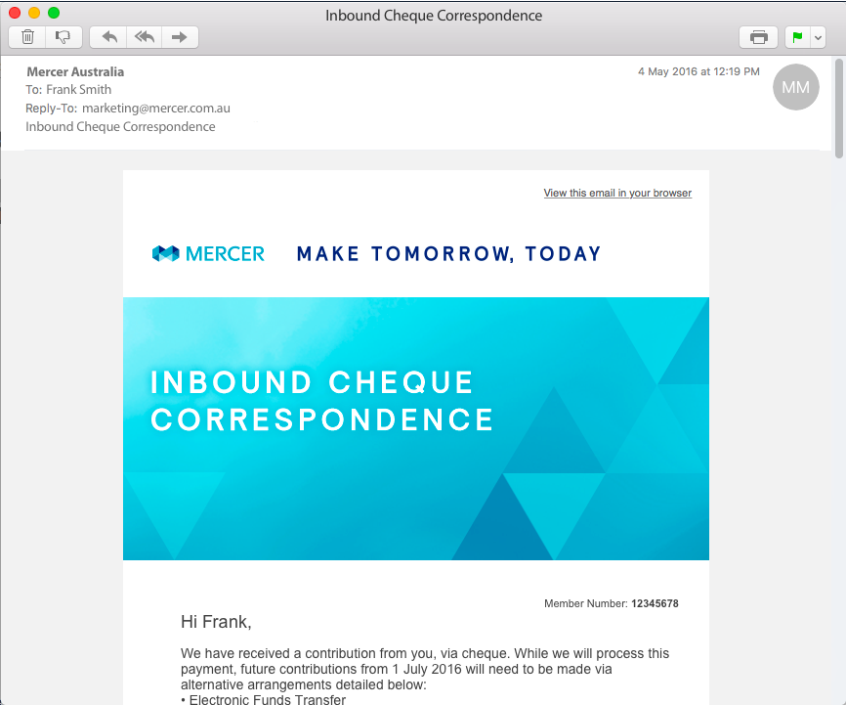
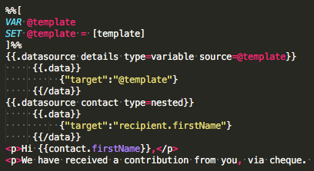
Real World Example
HOST: https://www.exacttargetapis.com POST contacts/v1/contactEvents Content-Type: application/json Authorization: Bearer insertAccessToken
{ "eventDefinitionKey":"CONTACT-EVENT-x…", "data":[{ "id": "5CE001F0-6B8F-E311-08EF6GXX", "name": “Correspondence Data", "items": [{ "values": [{ "name": "ContactKey", "value":"a0d1a000001OclAAAS" }, { "name": "template", "value":"{\"address1\":\"1 Smith Street\", \"address2\":\"TESTTOWN WA 7041\",\"address3\": \"\",\"associatedTitle\": \"Customer Service Team\", \"associated Title2\":\"Mercer Super
Mercer Australia
In Australia and New Zealand, Mercer serves 1.3m individuals and has over US$20bn in Funds Under Management (FUM) in Mercer products.
Using Marketing Cloud to automate member correspondence in highly sophisticated journeys
Contacts imported from Salesforce Sales Cloud
Using contactEvents method to serialise correspondence data into Data Extension and fire Event
Correspondence data stored as JSON in a Data Extension

Slide 13
Summary
1
2
3
Marketing Cloud enables near-time and real-time integration to third party platforms
Fuel REST API integration options include Events method and Contact Events method
Contact Model optimization is important
Consider leveraging other Marketing Cloud features in solution design

